Slide 1
Smart Bin by RedBin Team
Deepa
Harshal
Navya
Niyati
Preethi A
Sumangala Meti

Slide 2
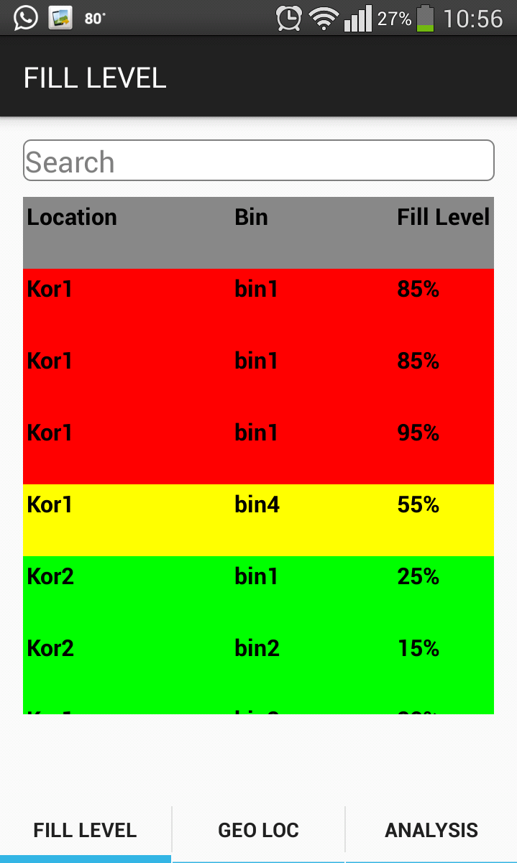
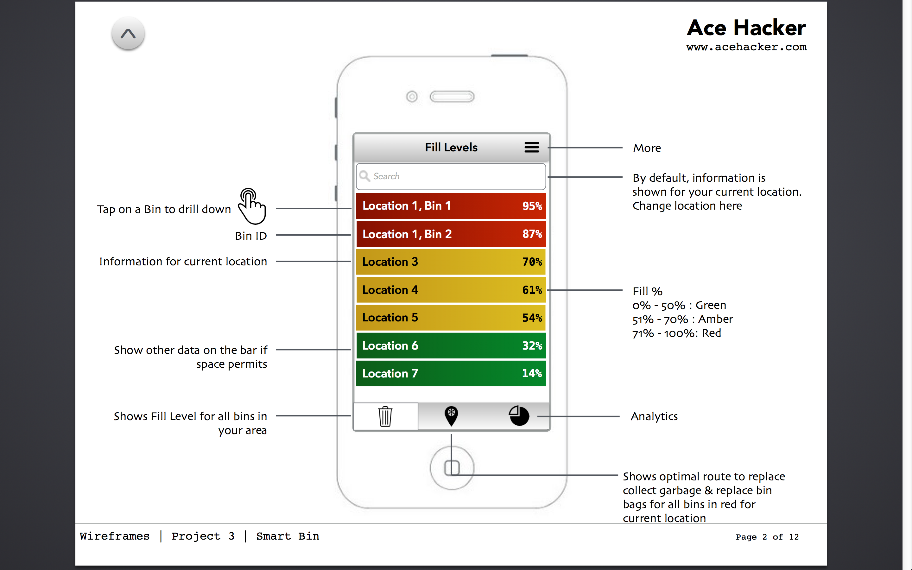
First Screen- Fill Levels
Implemented
Requirement

Slide 3
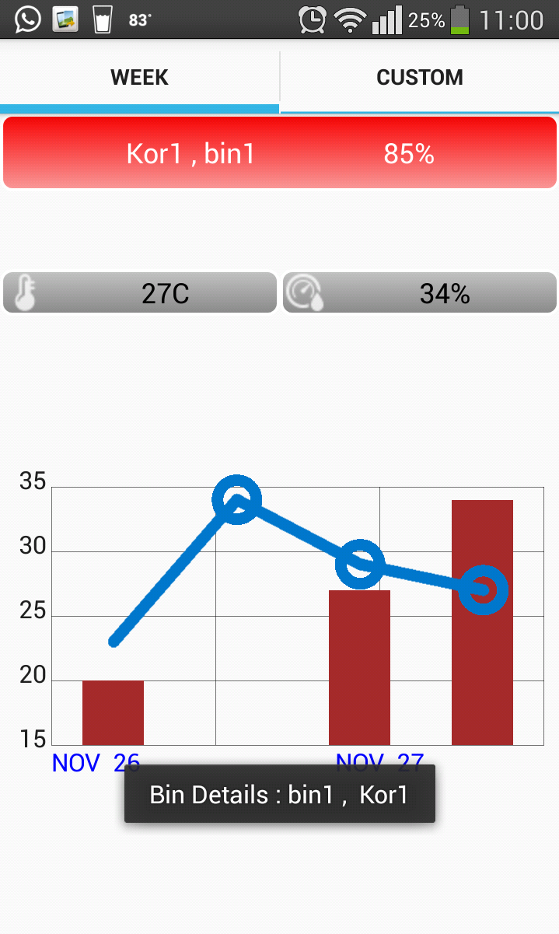
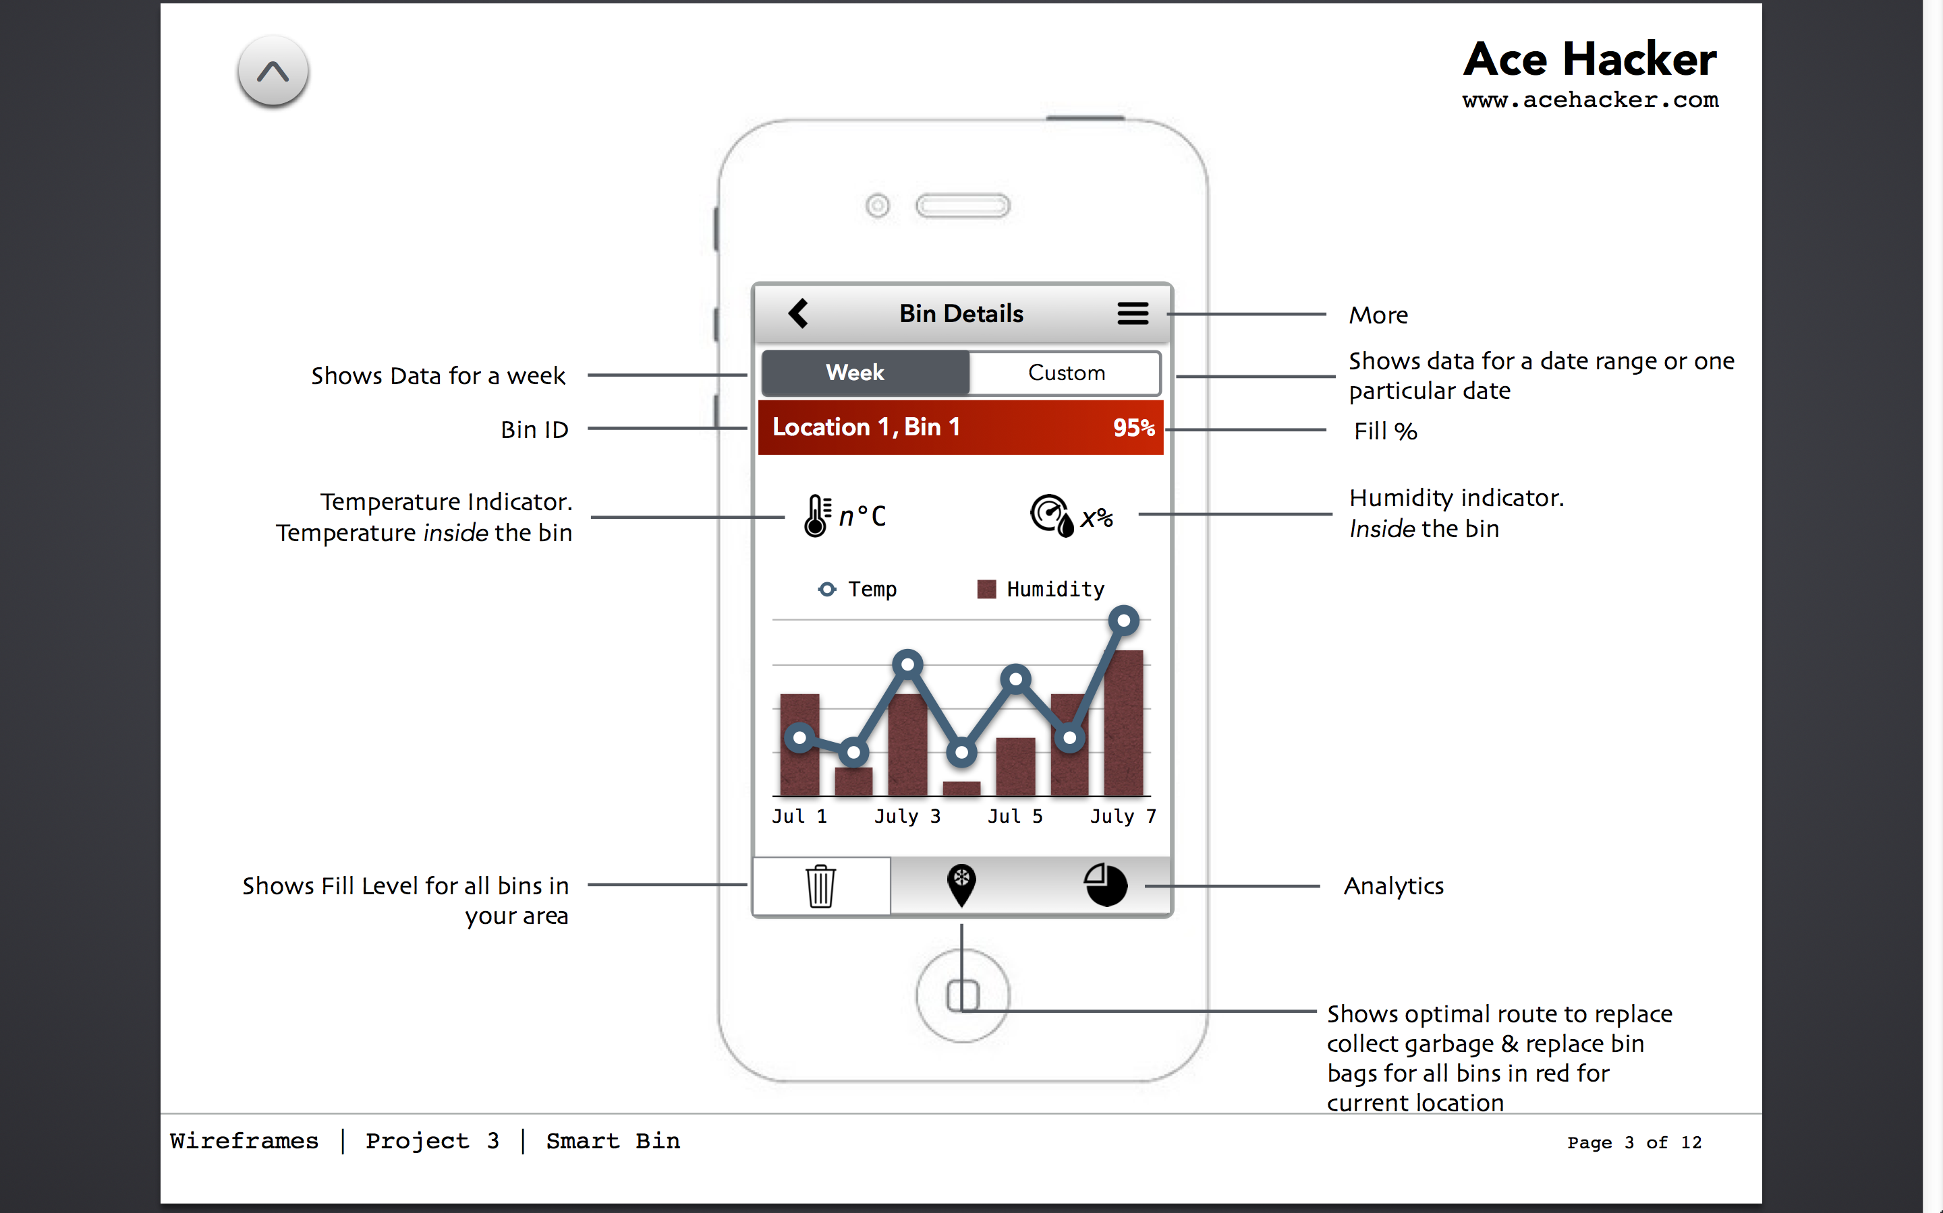
Second Screen – Bin Details
Implemented
Requirement

Slide 4
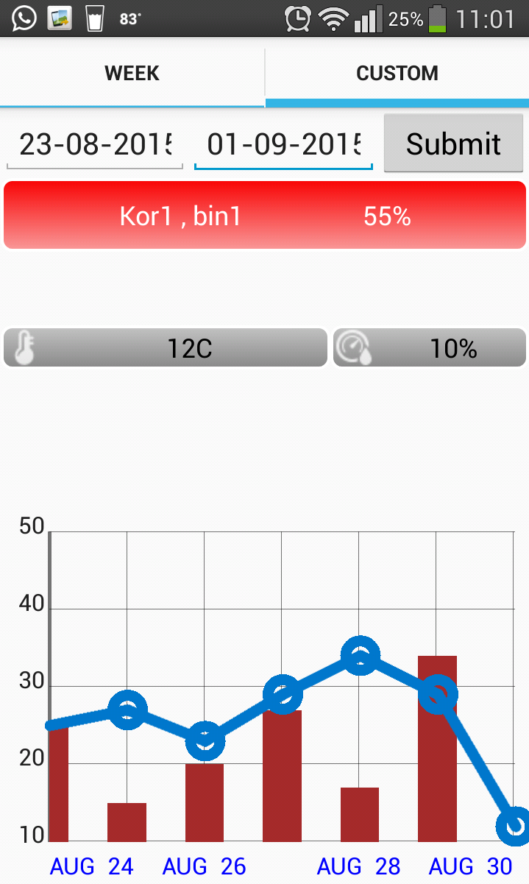
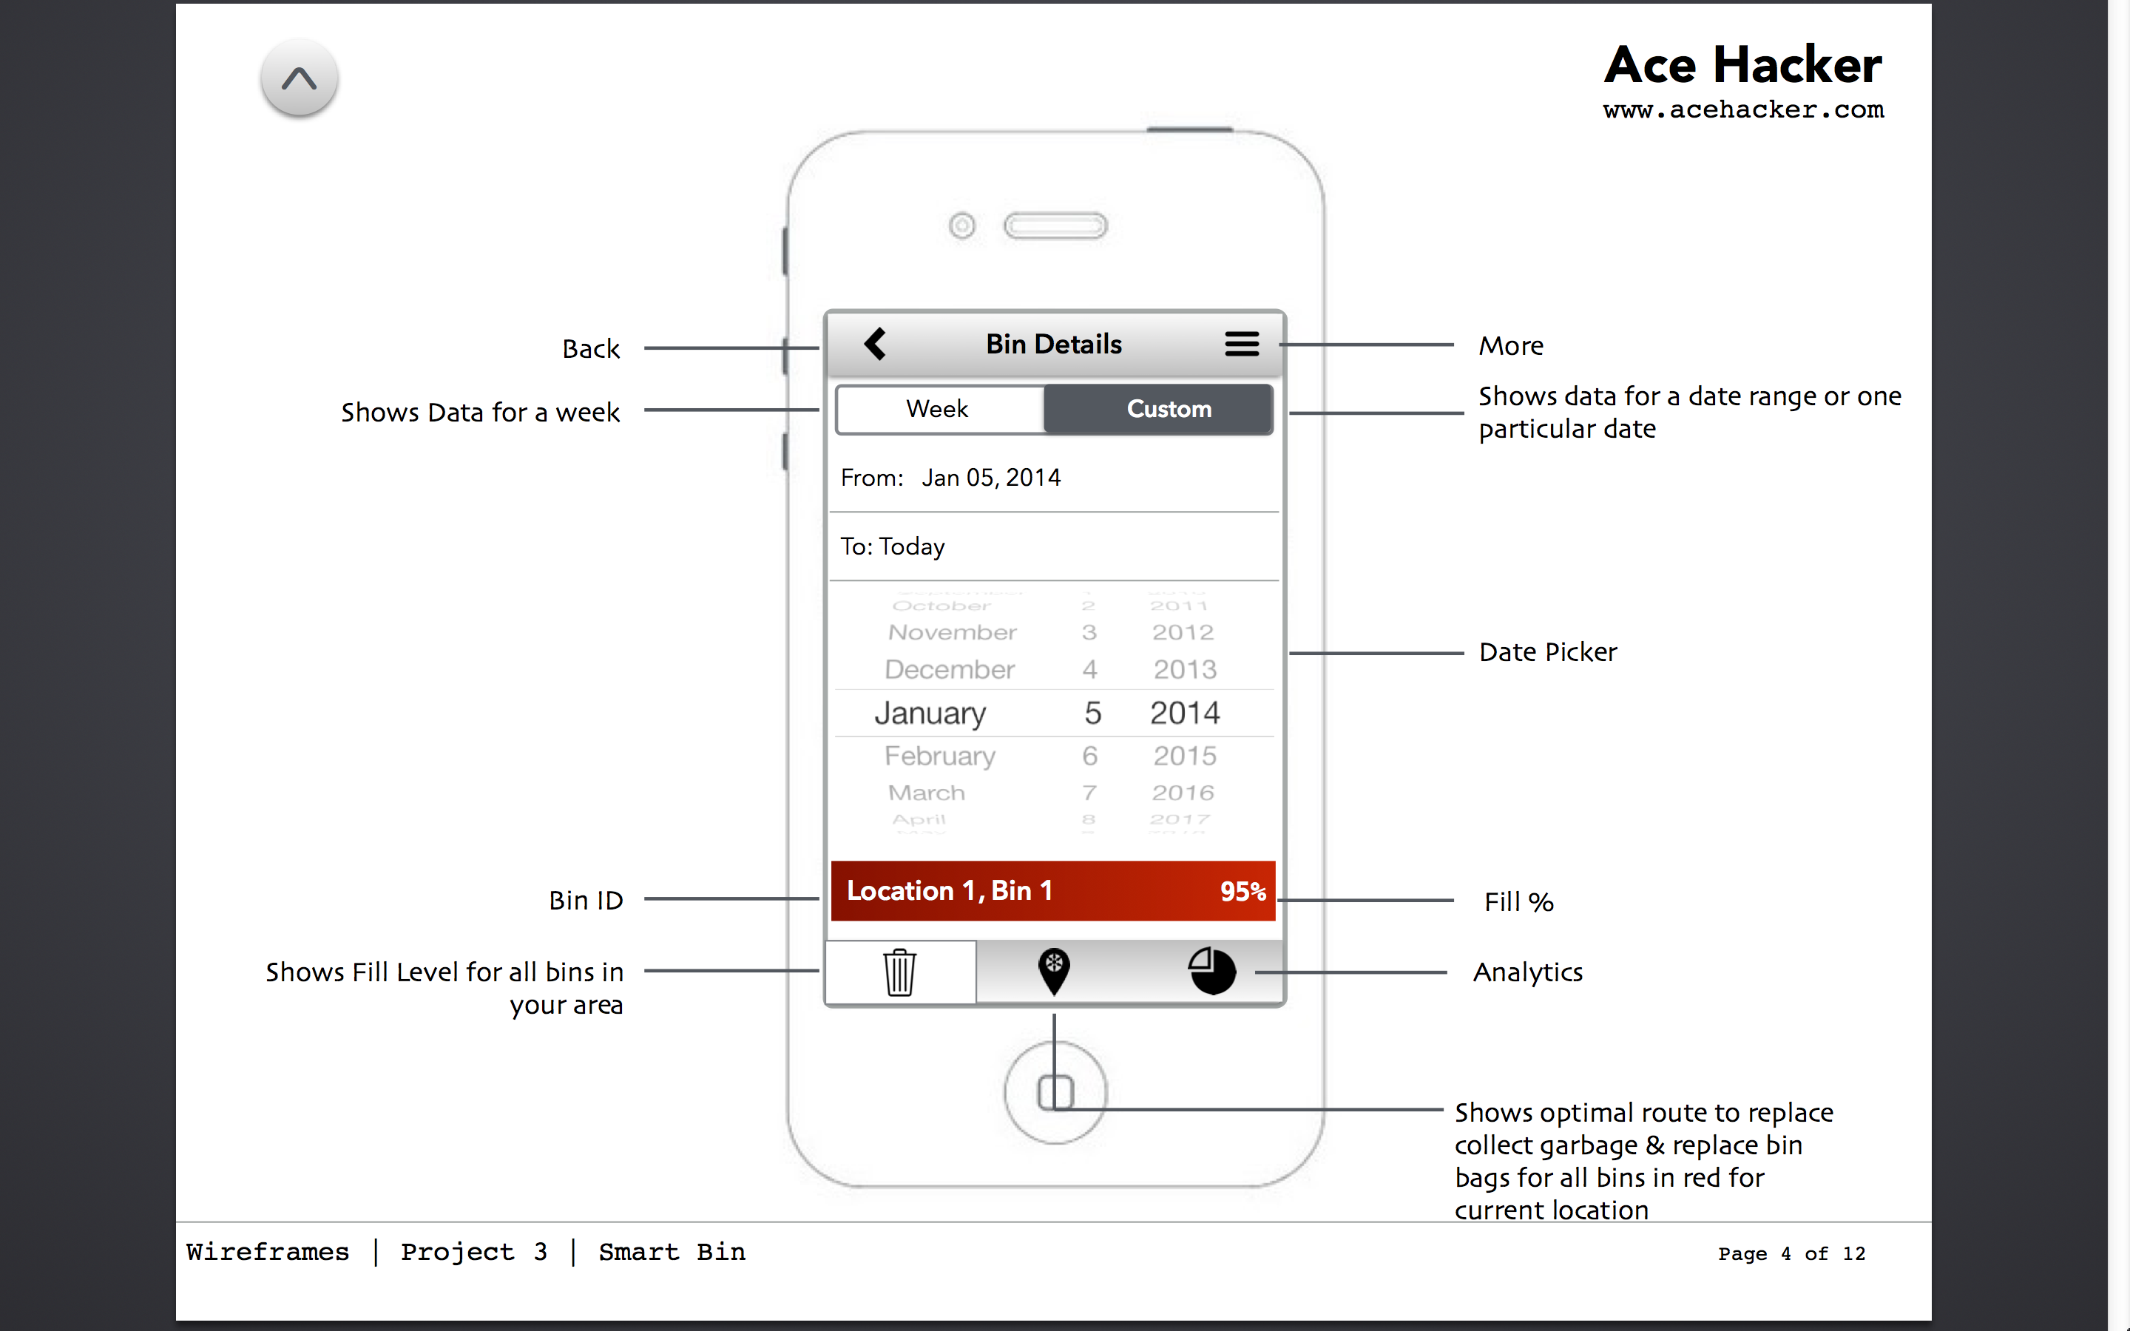
Third Slide – Bin Details
Implemented
Requirement

Slide 5
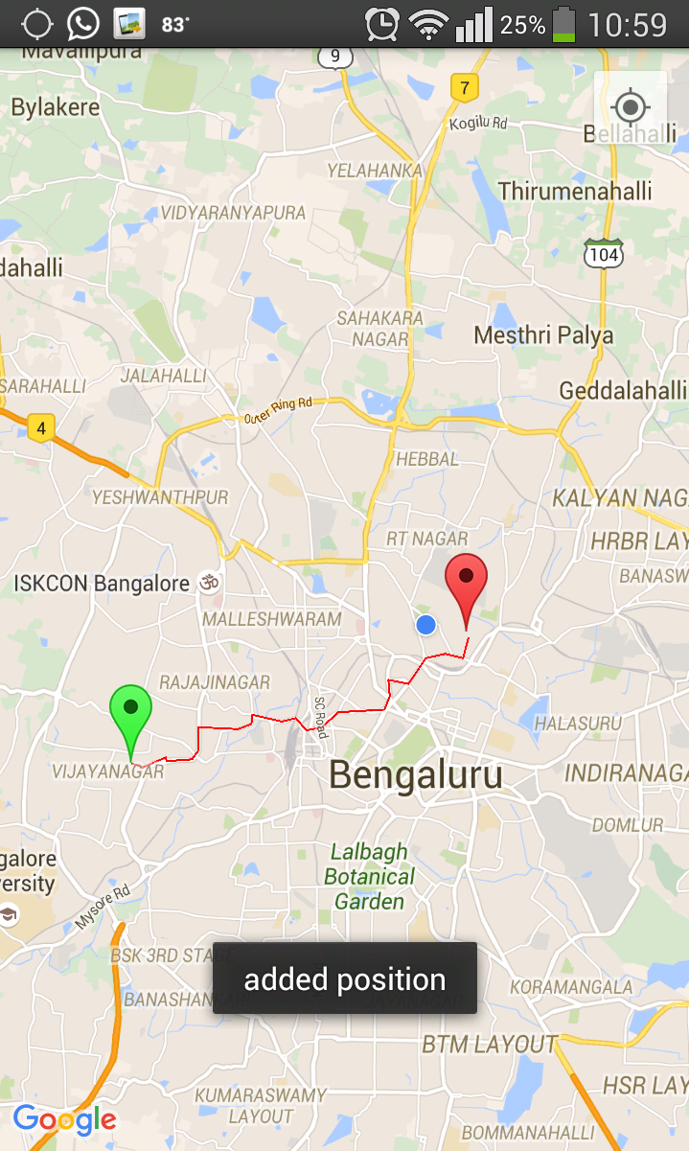
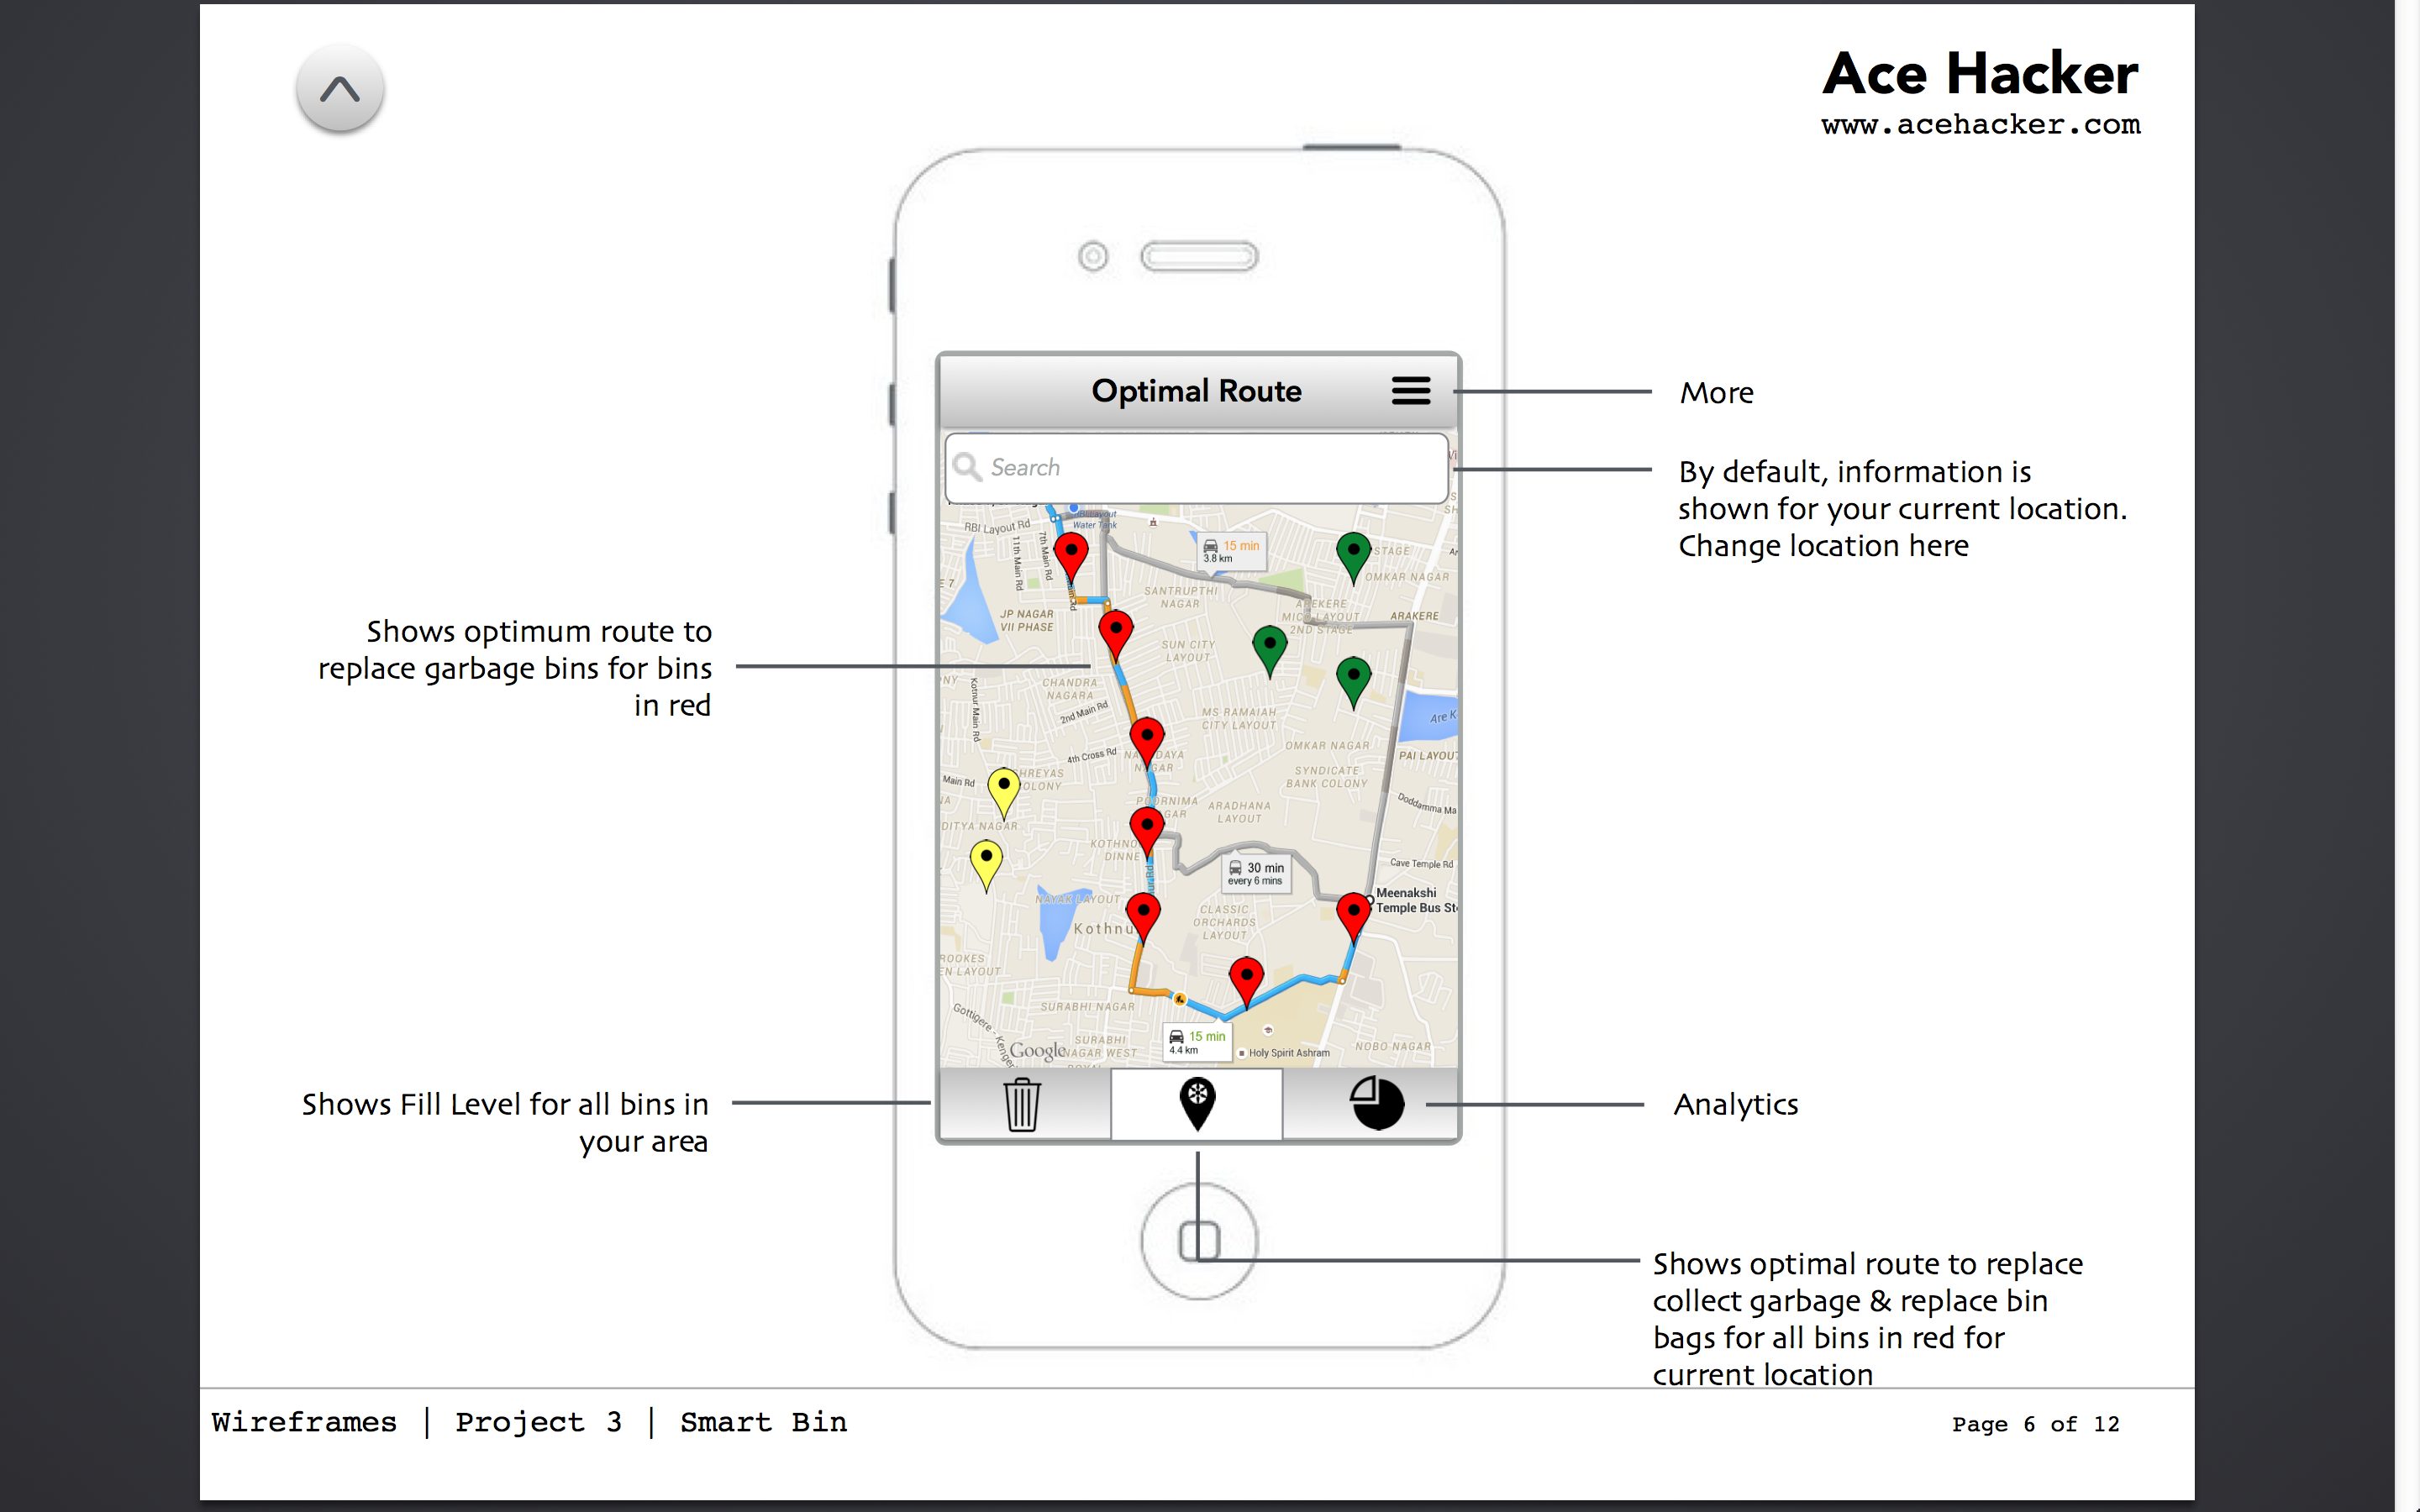
Fourth Slide – Optimal Route
Implemented
Requirement

Slide 6
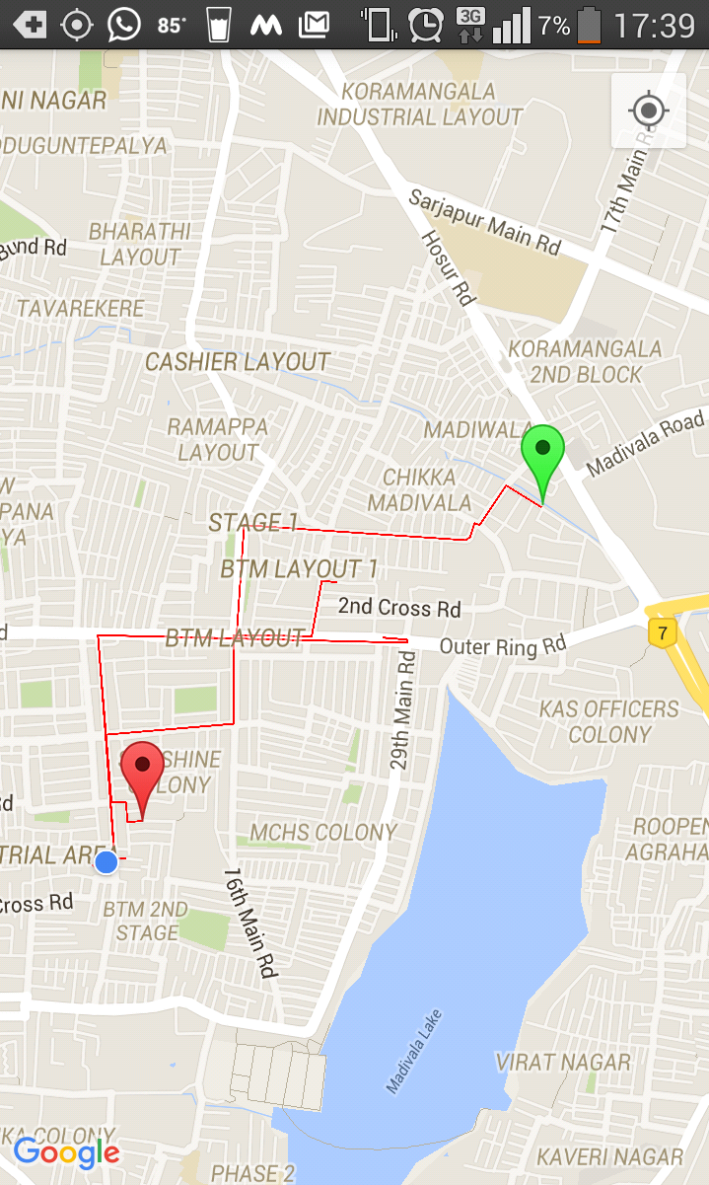
Fourth Slide – Optimal Route
Implemented
Requirement

Slide 7
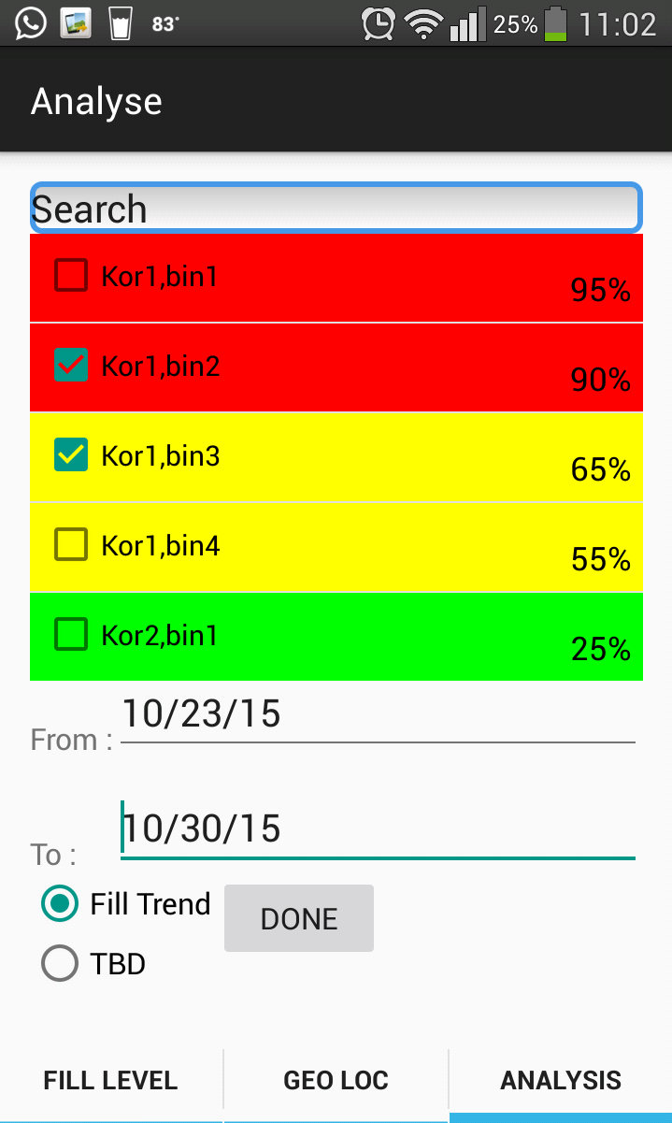
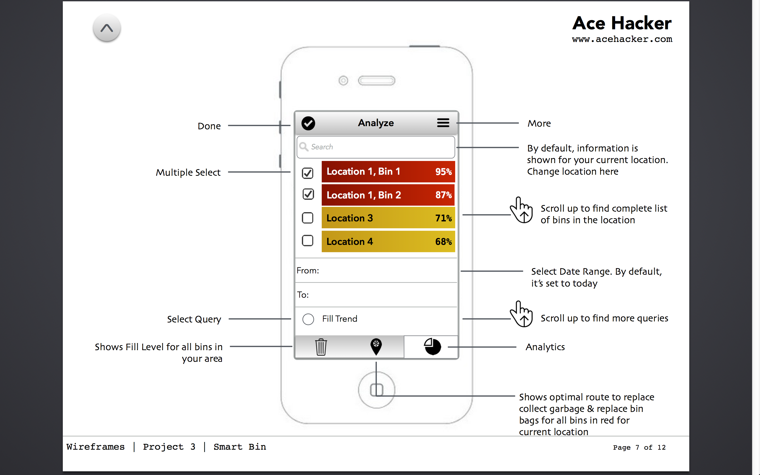
Fifth Slide – Analyze
Implemented
Requirement

Slide 8
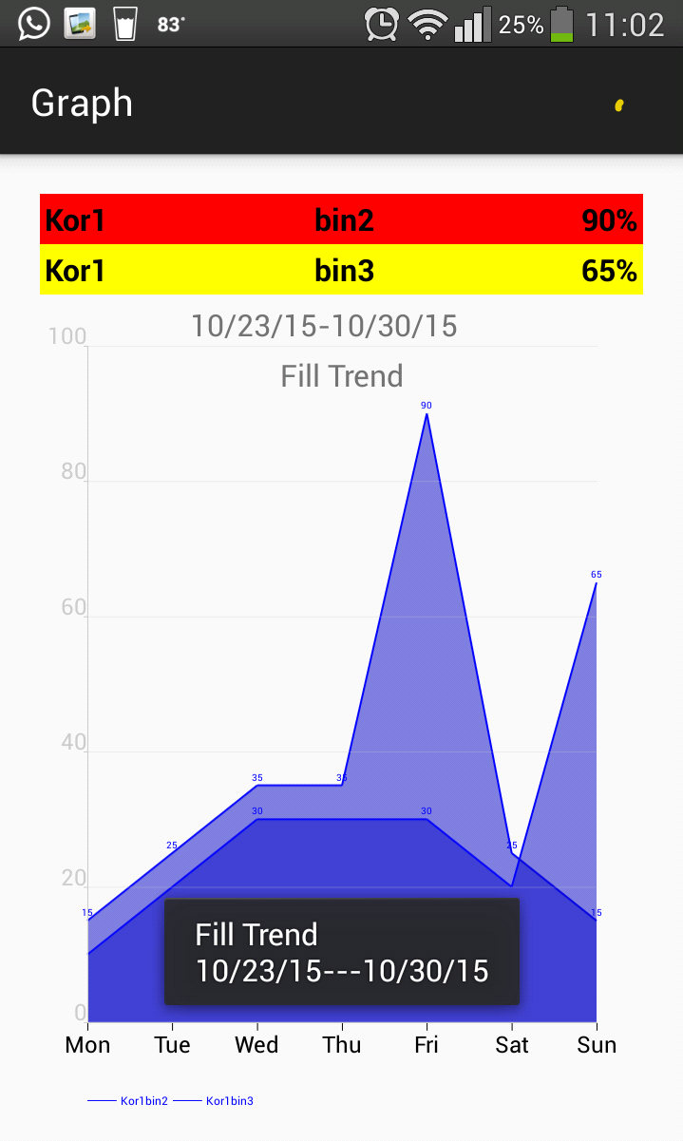
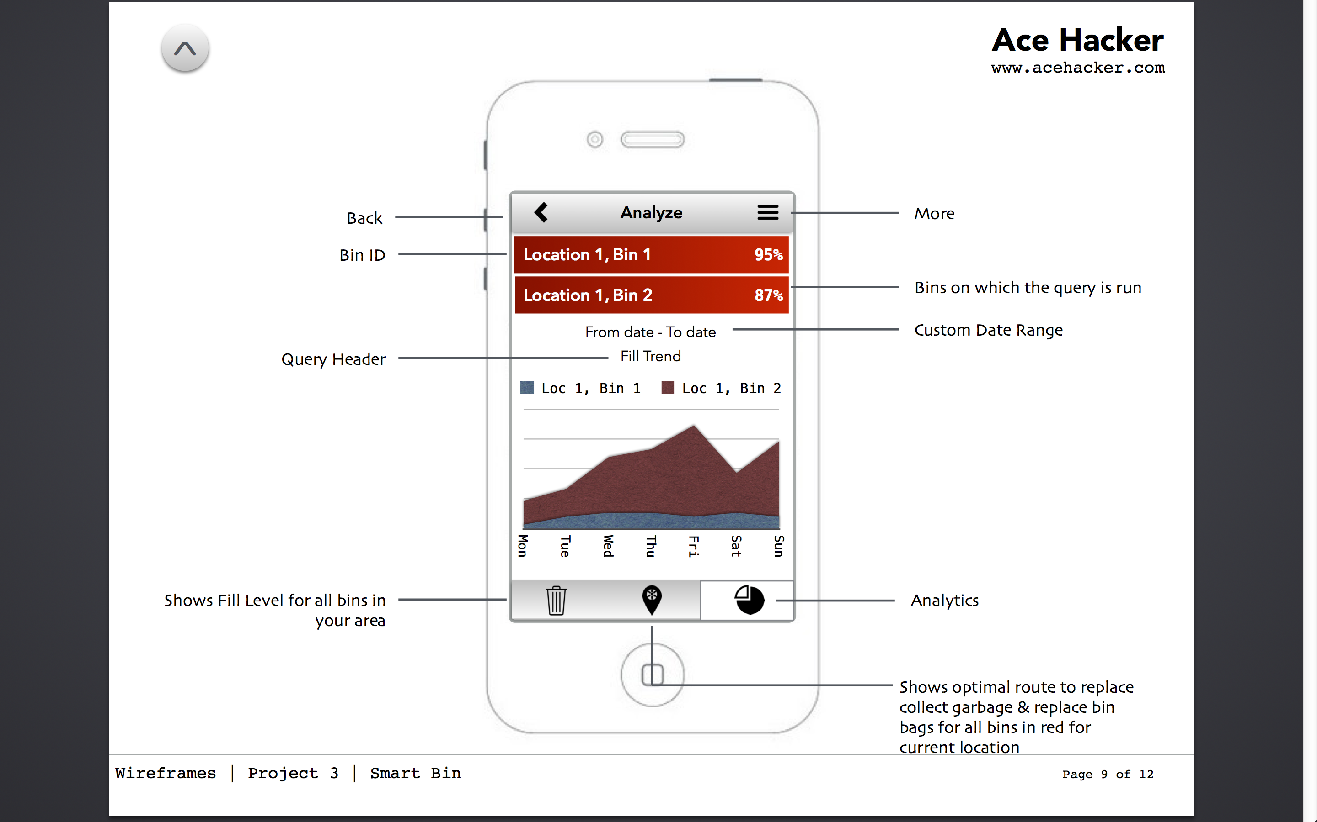
Sixth Slide - Analyze
Implemented
Requirement

Slide 9
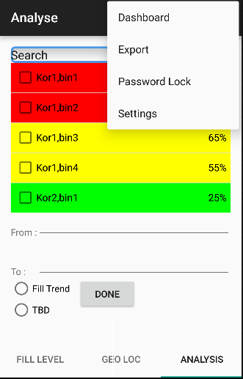
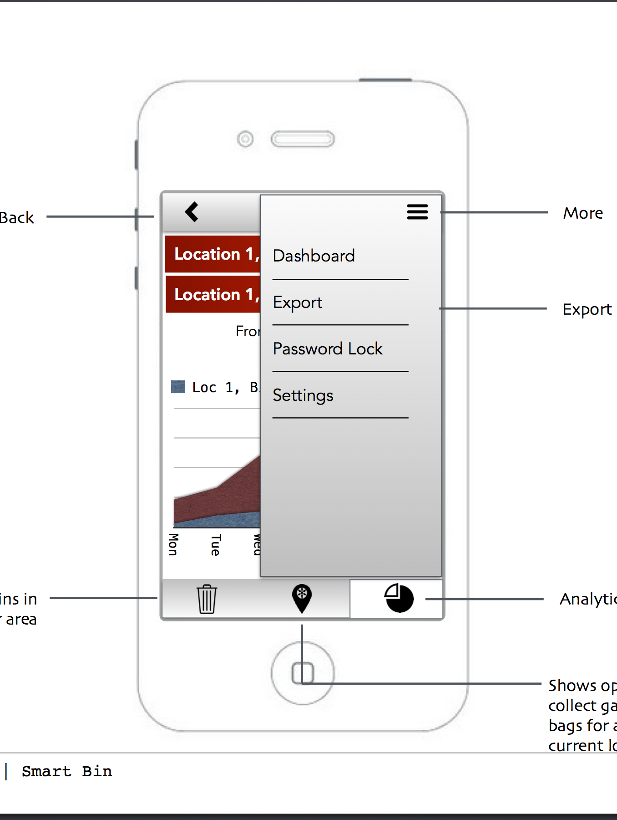
Seventh Slide – Analyze
Implemented
Requirement

Slide 10
Thank You

